Slide 1


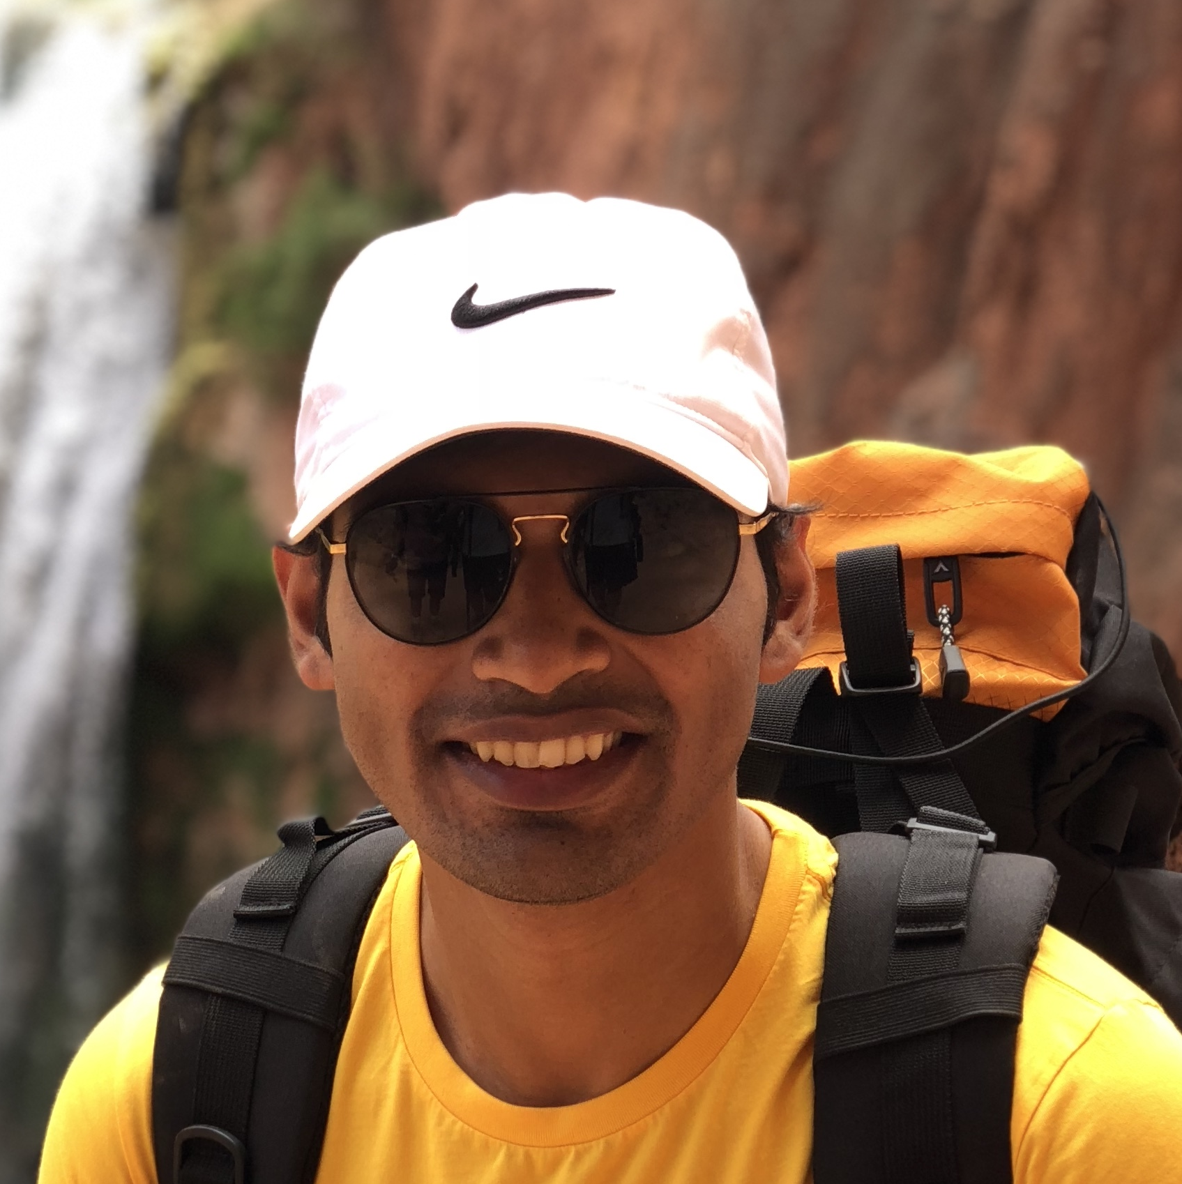

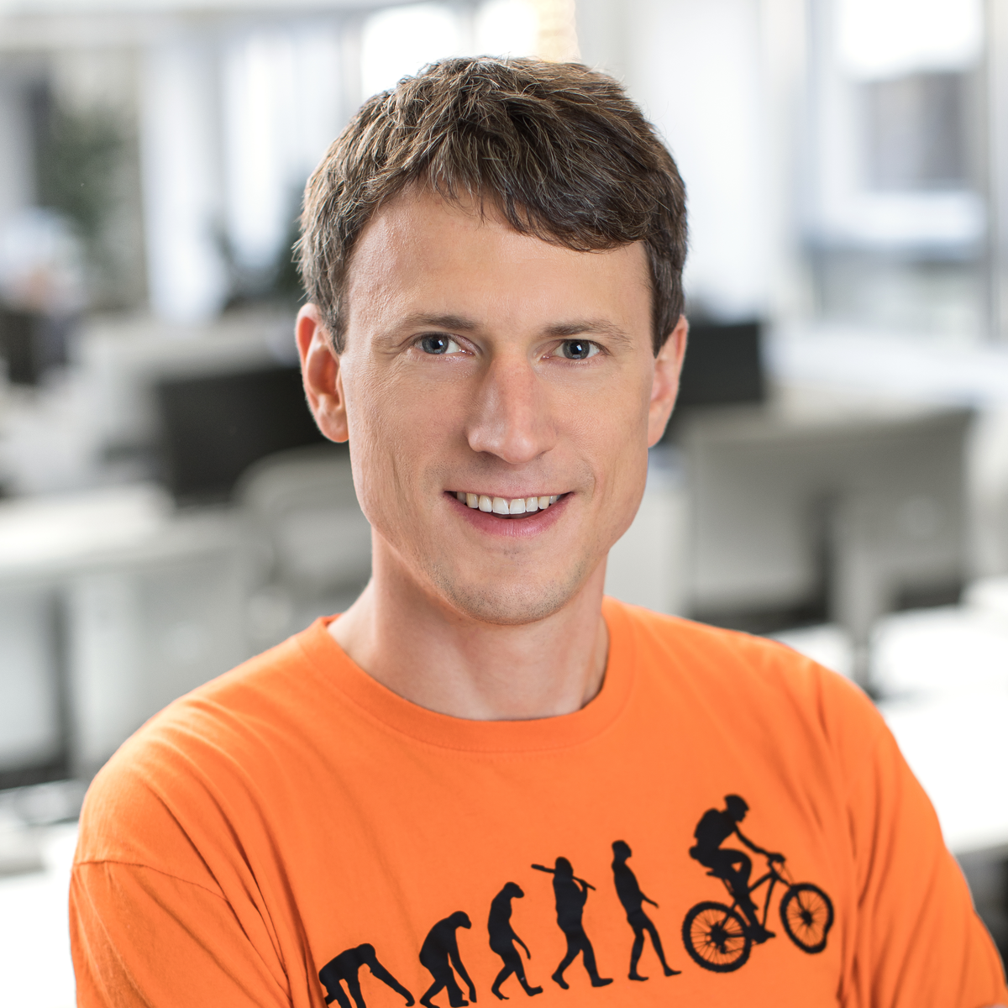


Towards a VQA Suite: Architecture Tweaks, Learning Rate Schedules, and Ensembling
Tina Jiang*, Vivek Natarajan*, Xinlei Chen*, Marcus Rohrbach, Dhruv Batra, Devi Parikh
June 18th, 2018

Slide 2
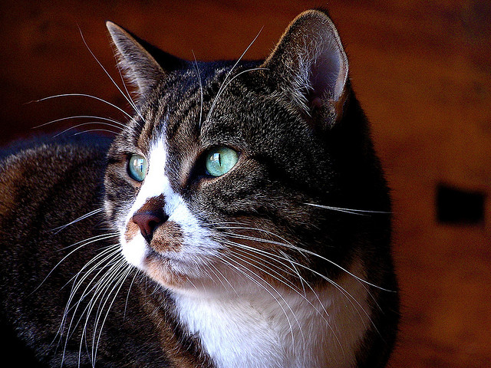
VQA architecture
Question Encoding
Multimodal Fusion
Classifier
What color are the cats eyes?
Green
Visual Feature Extraction
Notes:
Basic structure of VQA architech

Slide 3
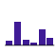
VQA Baseline Architecture: CNN + LSTM
Question
Word embedding
LSTM
FC
Element-wise product
FC
softmax
Cross-entropy loss
FC
Image
CNN
Agrawal et al. 2016
Notes:
The baseline model when VQA dataset get published

Slide 4
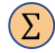
2016 VQA winner: Multimodal Compact Bilinear Pooling
Question
Word embedding
LSTM
MCB
FC
softmax
KL-DIV loss
MCB
conv
ReLU
conv
softmax
Image
CNN
$$∑$$
Fukui et al. 2016
Notes:
Propose a new way to combine the question and image modal

Slide 5

2017 VQA winner: Bottom-up and Top-down Attention
Question Encoding
Multimodal Fusion
Classifier
Question
Word embedding
GRU
Gated tan
Elt-wise prodcut
Gated tan
FC
Concate
Gated tan
FC
Softmax
Gated tan
+
Gated tan
FC
$$∑$$
Image
Faster-RCNN
Visual Feature Extraction
Teney et al. 2017
Notes:
Similar structure
Using object level feature instead of grid feature

Slide 6
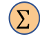
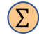
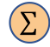
Multi-modal Factorized Bilinear Pooling with Co-Attention
Question Encoding
Multimodal Fusion
Classifier
Question attention
Question
LSTM
$$∑$$
conv
ReLU
conv
softmax
$$∑$$
MFB/MFH
FC
softmax
MFB/MFH
conv
ReLU
conv
softmax
concat
KL-DIV loss
softmax
Image
CNN
$$∑$$
Visual Feature Extraction
Yu et al 2017
Notes:
Based on MCB,
Add attention for questions

Slide 7
VQA-suite: Architecture Adaptation
Question Encoding
Multimodal Fusion
Classifier
Question attention
Question
LSTM
ReLU+ norm
$$∑$$
Elt-wise prodcut
conv
ReLU
conv
softmax
ReLU+norm
FC
Elt-wise product
ReLU+norm
FC
Softmax
ReLU+norm
+
ReLU+norm
FC
$$∑$$
Image
Faster-RCNN
Visual Feature Extraction
https://github.com/hengyuan-hu/bottom-up-attention-vqa
Notes:
VQA-suite: easily manipulate different modules
Get most infor form BUTD
Get question embedding from MFH

Slide 8
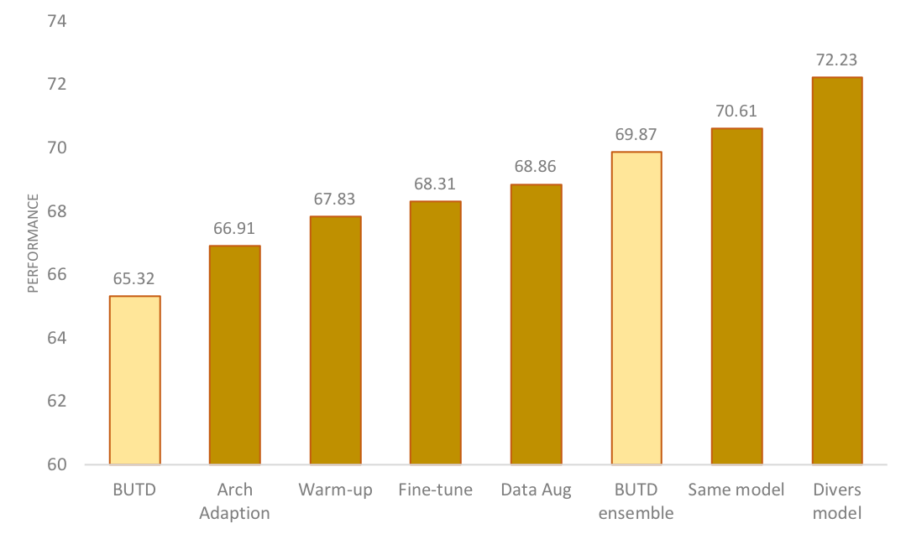
Architecture Adaptation
Accuracy:
Increased 1.6%

Slide 9
Techniques to Improve Performance
Adjust learning schedule
Finetuning image features
Data augmentation
Diversified model ensemble

Slide 10
Learning Schedule
warm-up
performance
Learning rate
batch size
Batch size: 512
Learning rate: 0.002 → 0.003
NAN
iters
Goyal el al. 2017

Slide 11
Techniques to Improve Performance
Adjust learning schedule
Accuracy: increased 0.9%
Finetuning image features
Data augmentation
Diversified model ensemble

Slide 12
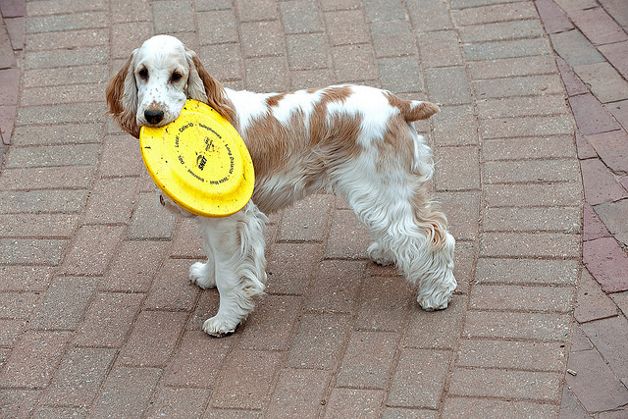
Fine-tuning Image Feature
Faster-RCNN
7x7x1024
7x7x2048
classes
res5
average
pooling
ROI projection
2048
box
attributes
Faster-RCNN with FPN
7x7x512
FC-6
FC-7
classes
FC, ReLU
FC, ReLU
2048
2048
box
ROI projection
attributes
Notes:
Fine tuning pre-trained features is a well known tech- nique to better tailor the features to the task at hand and thus improve model performance
BUTD use faster RCNN to extract features
FPN: Feature Pyramid Network
Easy to fine-tune the last few layers
CONFIRM: how attributes are added in loss

Slide 13
Techniques to Improve Performance
Adjust learning schedule
Accuracy: 66.91% --> 67.83%
Finetuning image features
Accuracy: increased 0.4%
Data augmentation
Diversified model ensemble

Slide 14
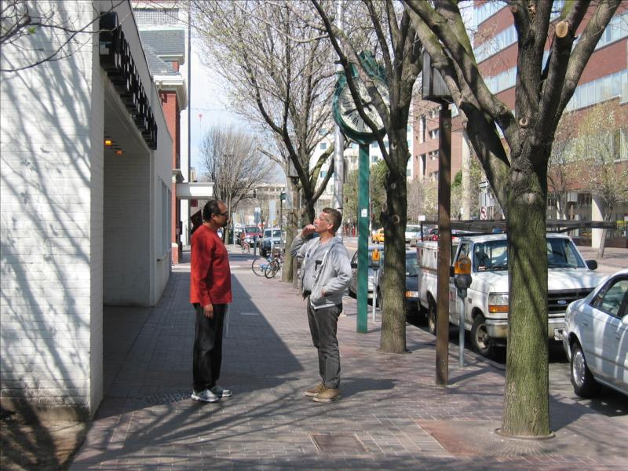
Data Augmentation: Visual Genome
108,249 images from the intersection of MS-COCO and YFCC
Remove questions with answer not in answer space
~ 682k questions
Repeat each answer 10 times
Q: What color is the clock?
A: Green
Krishna et al 2016
Notes:
YFCC: Yahoo Flickr Creative Commons 100 Million Dataset

Slide 15
Data Augmentation: Visual Dialog
Use COCO images
Change 10 turns of dialog to 10 questions
Repeat each answer 10 times
~423k questions
Das et al. 2017

Slide 16
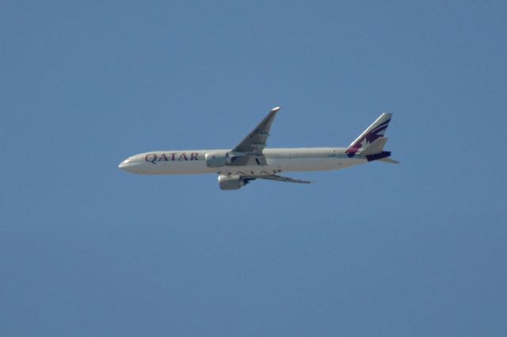

Data Augmentation: Mirrored Image
Interchanging tokens “left” and “right” in questions and answers
Q: What direction is the plane pointed?
A: left ➔ A: right

Slide 17
Techniques to Improve Performance
Adjust learning schedule
Accuracy: 66.91% --> 67.83%
Finetuning image features
Accuracy: 67.83% --> 68.31%
Data augmentation
Faster-RCNN: 67.83% --> 68.52%
Finetune: 68.31% --> 68.86%
Diversified model ensemble

Slide 18
Techniques to Improve Performance
Adjust learning schedule
Accuracy: 66.91% --> 67.83%
Finetuning image features
Accuracy: 67.83% --> 68.31%
Data augmentation
Faster-RCNN: 67.83% --> 68.52%
Finetune: 68.31% --> 68.86%
Diversified model ensemble

Slide 19
Model Ensemble
Strategy 1:
Best models with different seeds
Strategy 2:
Diversified models
Different training dataset
Different image features
72.23
performance
Same models
number of models

Slide 20
Performance Improvement
VQA Challenge:
test-dev : 72.12
test-standard : 72.25
test-challenge: 72.41

Slide 21
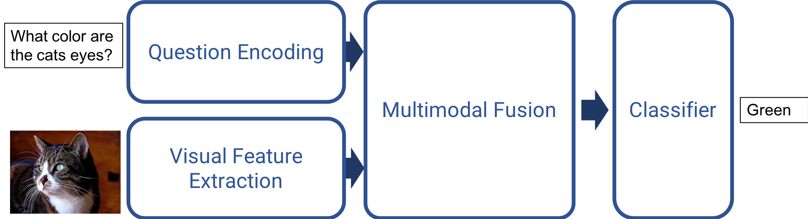
Summary
Model architecture adaption, adjusting learning schedule, image fine-tune and data augmentation improved the single model performance
Diversified model can significantly improve ensemble performance
VQA-suite enabled all of these functionalities
Open source our codebase
Notes:
Emphasize the modularity and easy for others to change

Slide 22






Acknowledgments
Poster Here
Vivek Natarajan
Xinlei Chen
Marcus Rohrbach
Dhruv Batra
Devi Parikh
Peter Anderson
Abhishek Das
Stefan Lee
Jiasen Lu
Jianwei Yang
Deshraj Yadav

